Slide 1
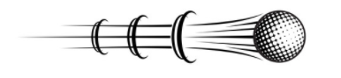
Fast Moving Objects
Tracking and Estimating Trajectory of
With Temporal and Spatial Information
Kristi Bushman & Clara C. Ferreira & Avery Peiffer
Notes:
Cite image:
https://www.vectorstock.com/royalty-free-vector/golf-symbols-movement-set-vector-26554480

Slide 2
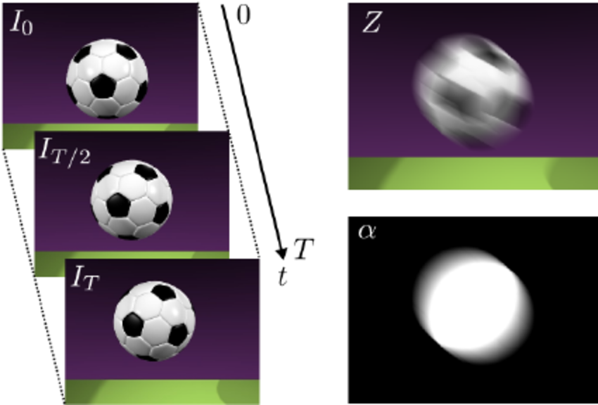
What is an FMO?
Object moving a distance greater than its diameter during a camera’s exposure time.
Notes:
Ball is in multiple places; show blurred and ground truth
Soccer ball: https://www.researchgate.net/figure/Blurred-image-formation-model-The-blurred-image-Z-is-obtained-as-the-temporal_fig2_221415408/download

Slide 3
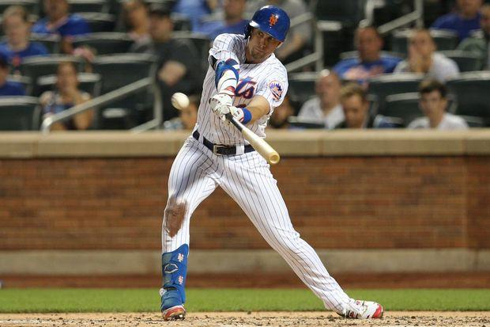
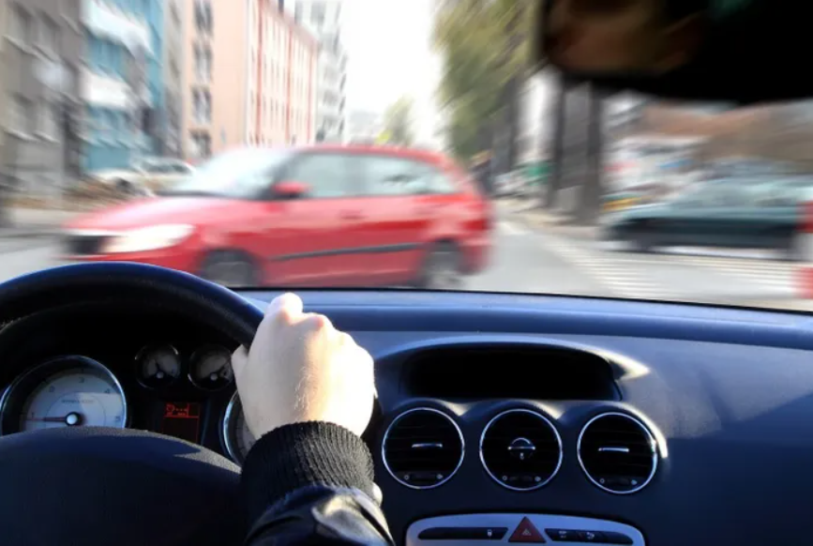
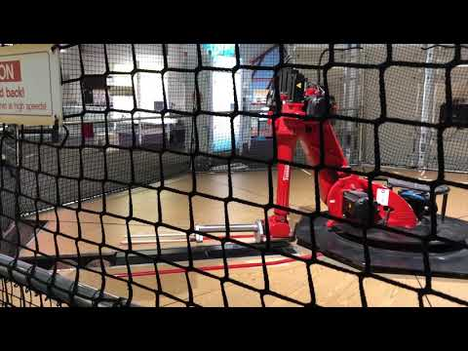
Importance of Tracking FMOs
sports
autonomous vehicles
robotics
Notes:
Explain what problem we are trying to solve by saying:
what FMOs are + which applications it can be found in?
Can prevent accidents/ unexpected abrupt objects Capture interest and show importance of project
Cite images:
Auto vehicle: https://www.msglassoutlet.com/4-ways-your-windshield-protects-your-family-during-an-auto-accident

Slide 4
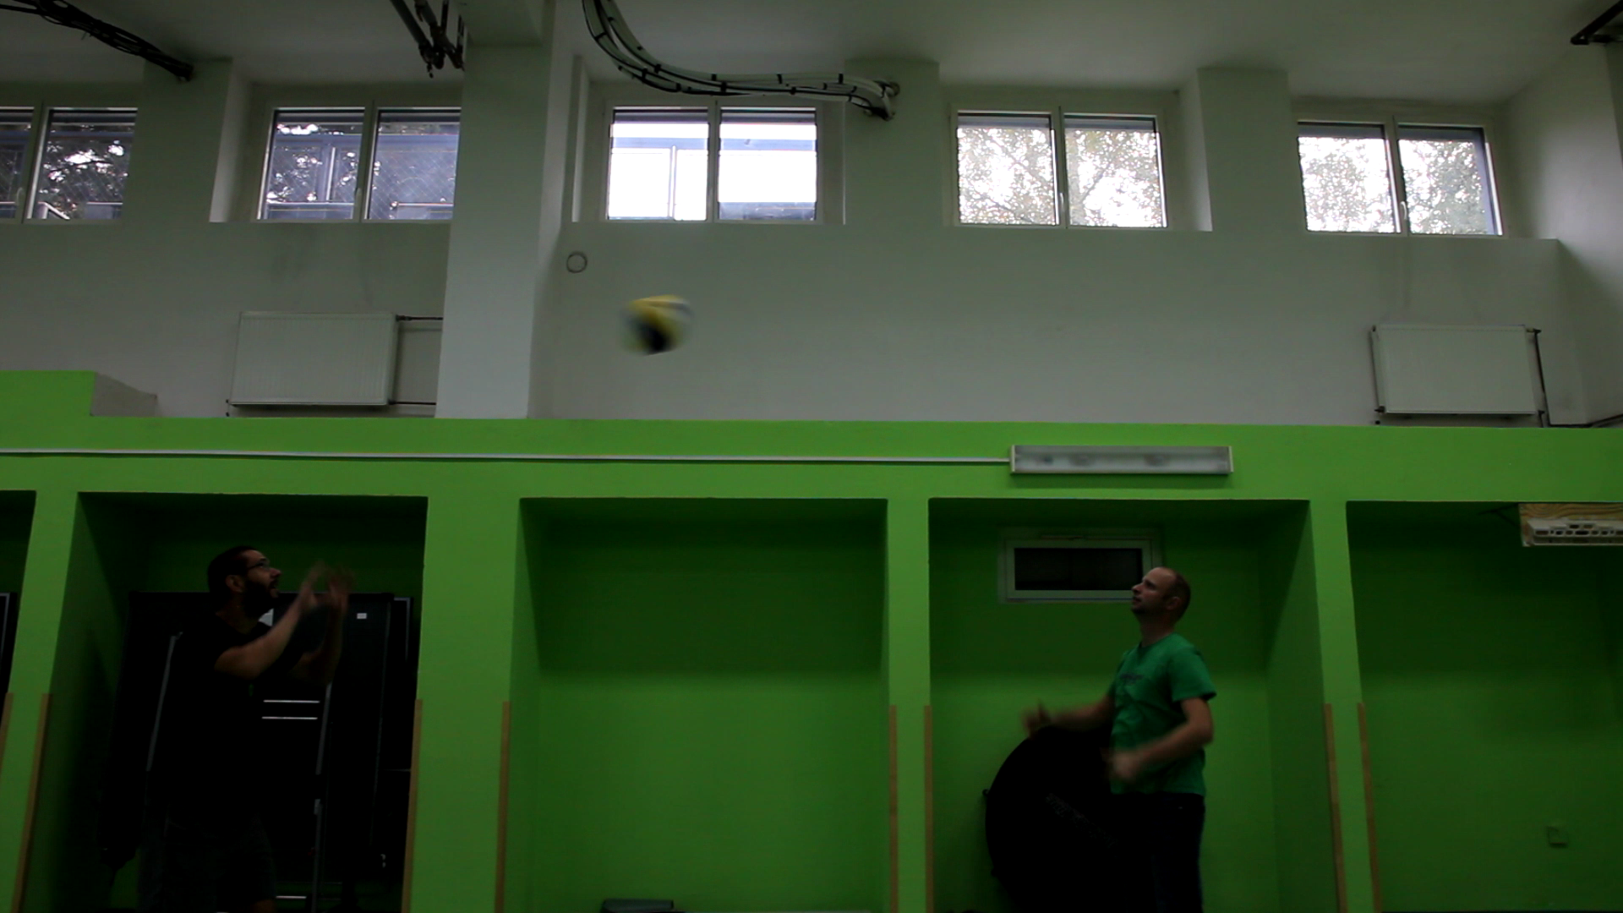
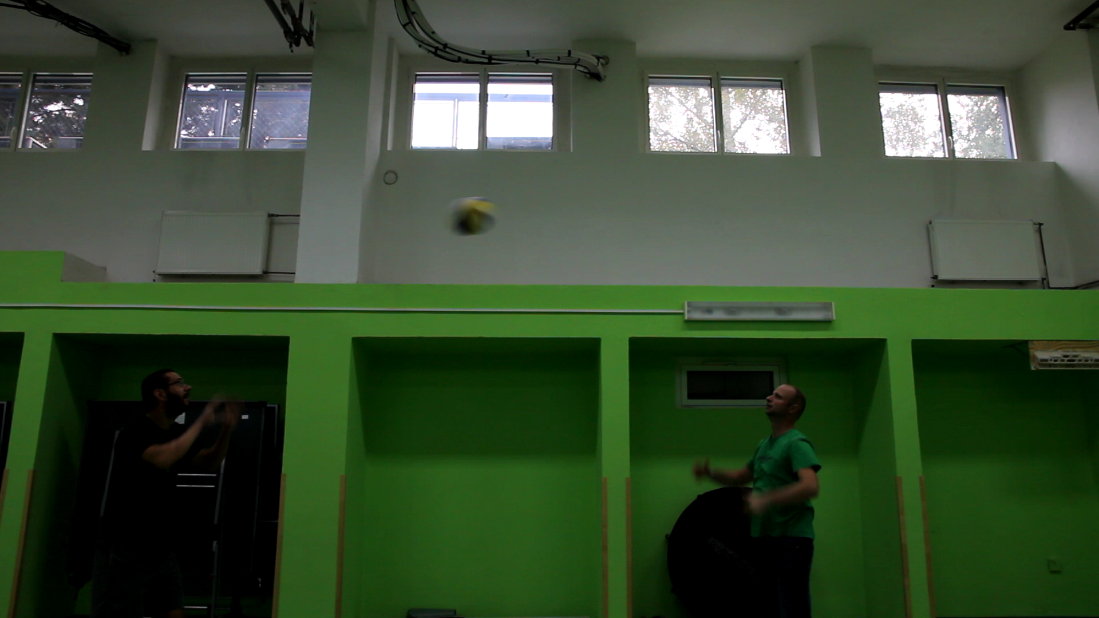
FMO Properties - distorted shape and inconsistent appearance
Frame #1
Frame #2

Slide 5
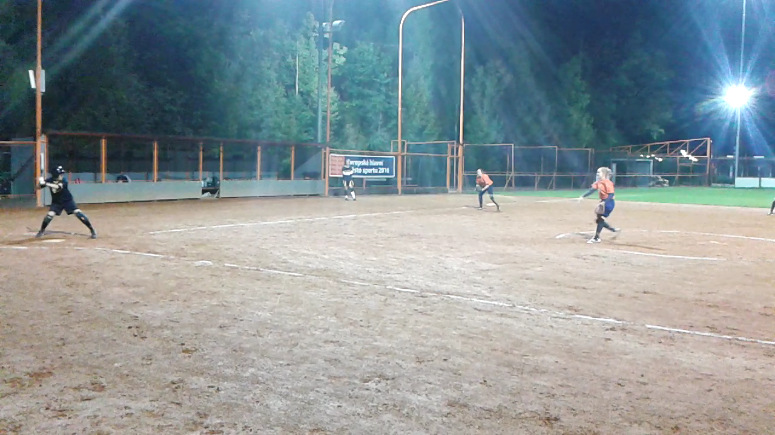
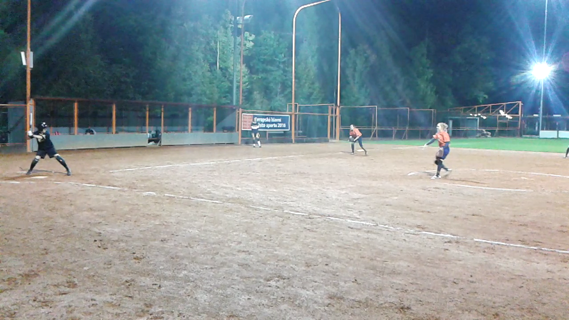
FMO Properties - blurred and small
Frame #1
Frame #2
Notes:
Explain what is an

Slide 6
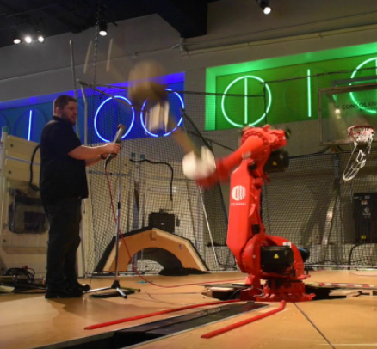
FMO Difficulties/Applications
sports
autonomous vehicles
distorted baseball
blurry obstacles
robotics
acceleration
Notes:
Explain what problem we are trying to slve by saying:
what FMOs are + which applications it can be found in?
Can prevent accidents/ unexpected abrupt objects Capture interest and show importance of project
Cite images:
Auto vehicle: https://www.msglassoutlet.com/4-ways-your-windshield-protects-your-family-during-an-auto-accident

Slide 7
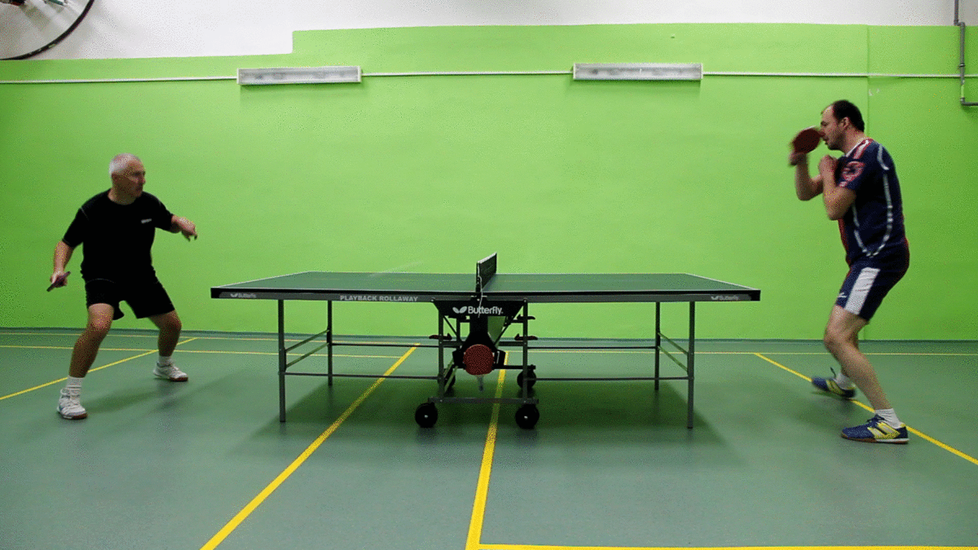
High-Level Task
Track FMOs using segmentation
Predict FMO in future frames (trajectory)
Evaluate on FMOv2 dataset
20 videos of FMOs in different domains (mostly sports)
Commonly cited dataset
Only FMO dataset with segmented ground truth
Compare to existing methods

Slide 8
Prior Work
Tracking FMOs
Trajectory Estimation

Slide 9
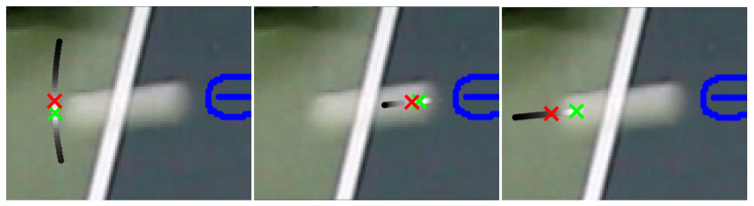
Tracking FMOs
The World of Fast Moving Objects - Rozumnyi et al.
Created the FMO dataset
Used a series of image processing techniques and theoretical model of FMOs
Created a series of 3 algorithms for tracking and detection
Detector, Re-detector, Tracker
Used information from surrounding frames to help locate the FMO
NOT a learning-based method
Notes:
Tracking steps. (1) detection of orientation, (2) detection of starting point, (3) detection of ending point. Previous detection is in blue. Green cross denotes the minimizer, red crosses the initial guess. All sampled points (gray) are scaled by their cost (6) (the darker the higher cost) How clearly did the authors describe their proposed approach? (1-10)

Slide 10
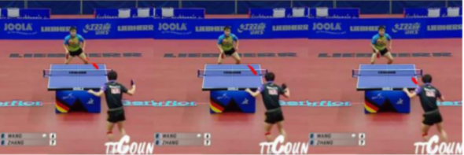
Tracking FMOs
Tracking Fast Moving Objects by Segmentation Network - Zita, Sroubek
Created a synthetic dataset for FMOs from YouTube sports videos
Used deep-learning for detecting FMOs using ENet architecture
Traditional convolutional neural network
Trained two models - one for large objects and one for small objects
Notes:
Only using ENet CNN → we expand upon this
Not true real-time performance
Multiple models (not end-to-end?)

Slide 11
Tracking FMOs
Tracking Fast Moving Objects by Segmentation Network - Zita, Sroubek
Created a synthetic dataset for FMOs from YouTube sports videos
Used deep-learning for detecting FMOs using ENet architecture
Traditional convolutional neural network
Trained two models - one for large objects and one for small objects
Notes:
Only using ENet CNN → we expand upon this
Not true real-time performance
Multiple models (not end-to-end?)

Slide 12
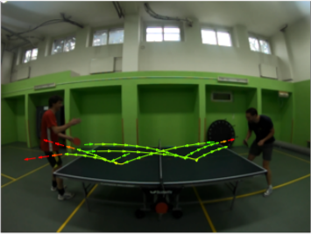
Trajectory Estimation
Tracking by Deblatting - Rozumnyi et al.
Estimate trajectory by:
Locating object in each frame
Fitting a smooth curve to the path of the object

Slide 13
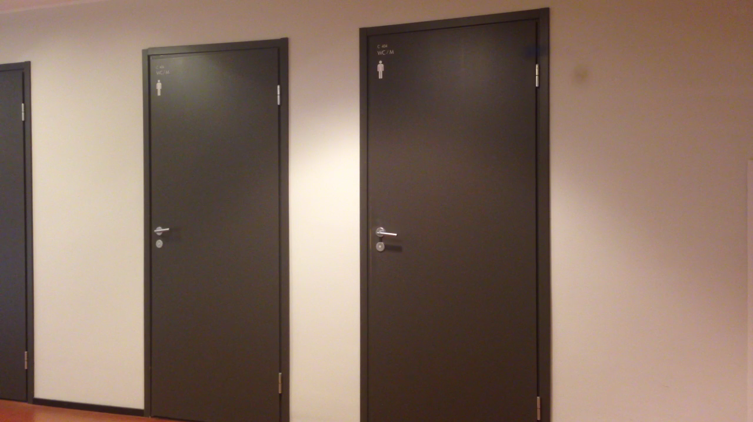
Exercise: Where is the FMO?
Notes:
Frame from a video in FMOv2 dataset - 20 videos of different types of FMOs (mostly from sports)

Slide 14
difficult to detect in a one-off manner
Idea: Let’s use information from the previous frames to help us locate the FMO.

Slide 15
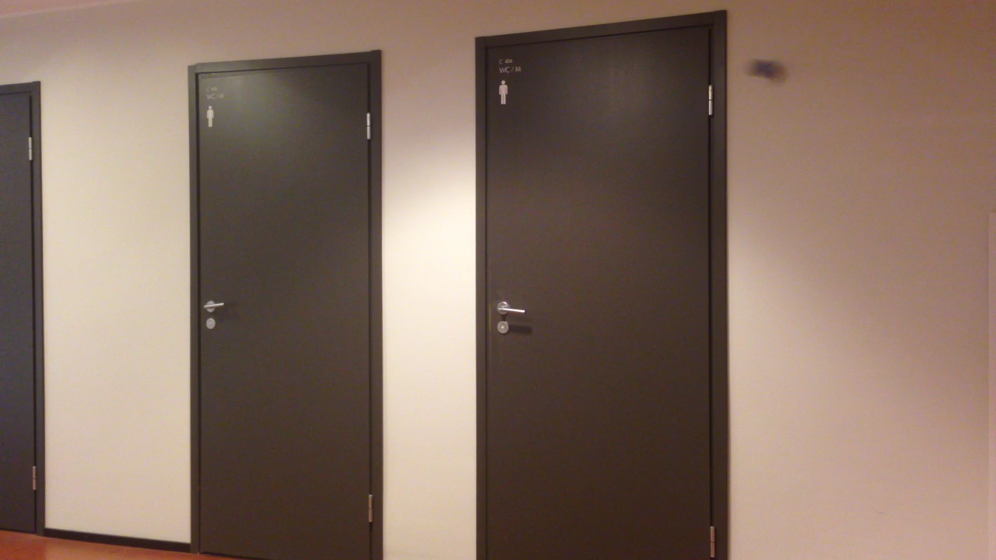

Slide 16
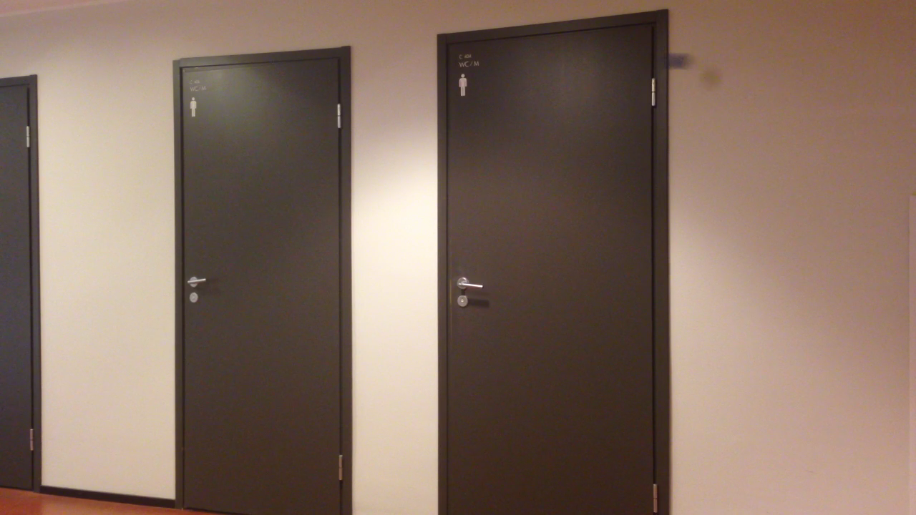

Slide 18


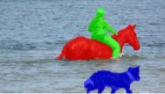
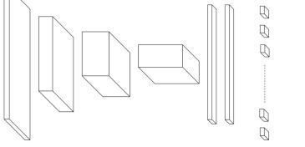
Setup runtime environment
Create dataset generator and acquire test dataset
Use recurrent segmentation network (RVOS)
Train and evaluate
Approach to track and predict future frames
Trajectory prediction
Notes:
Our approach to tracking and predicting fast objects in a predetermined future frame involved a series of five main steps.
Setting up the code, choosing and creating a trainable dataset, understanding the network and coming up with improvement, as well as optimizing and comparing our model.

Slide 19
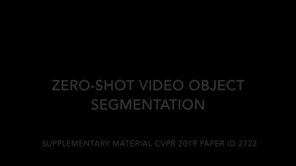

Set up Runtime Environment
Notes:
We chose to use both Colab and Pitt CRC to run an existing code-base called RVOS. RVOS incorporates both spatial and temporal information into training, which we would expect to be helpful in detecting the varying properties of FMOs. It is the fastest real-time object segmentation tracking method that meets performance requirements with no initial user input label necessary.
The video above shows that RVOS does zero-shot object segmentation tracking, meaning that it does not need an initial ground truth label to segment and track realtime.
#Make clear that Segmentation tracking RVOs was already done

Slide 20
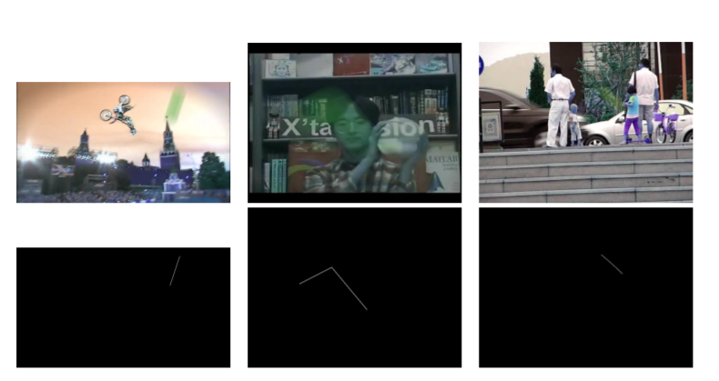
Dataset - Synthetic Image Dataset Generator (previously developed)
Modifiable code with diverse customization opportunities
Notes:
To train the FMO dataset with machine learning, we need a lot of data. We initially expected to use an existing dataset generator from previous research, but we were not able to access it as previously assured by other researchers. We WERE able to find a different dataset generator, but it only contained random images of FMOs rather than videos. As it can be seen above, this existing dataset generator ground truth only generated the path of the object rather than the segmented object.
Images- gound truth is line not seggmented FMO. Previously that line was used for trajectory estime
Found FMOv2 for testing but we need to make training

Slide 21
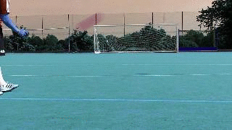
Dataset - Synthetic Video Dataset Generator (original)
Large and controllable amount of data
Modifiable
Logical trajectory among frames
Background video
Notes:
Computer vision concepts helped us create a segmented ground truth, and turn the generated images into videos of logical trajectories.
We also combined a video dataset with our dataset generator. The video dataset replaced the background images of the synthetic dataset to make our training data more realistic, which improves training as we will later describe in detail.

Slide 22
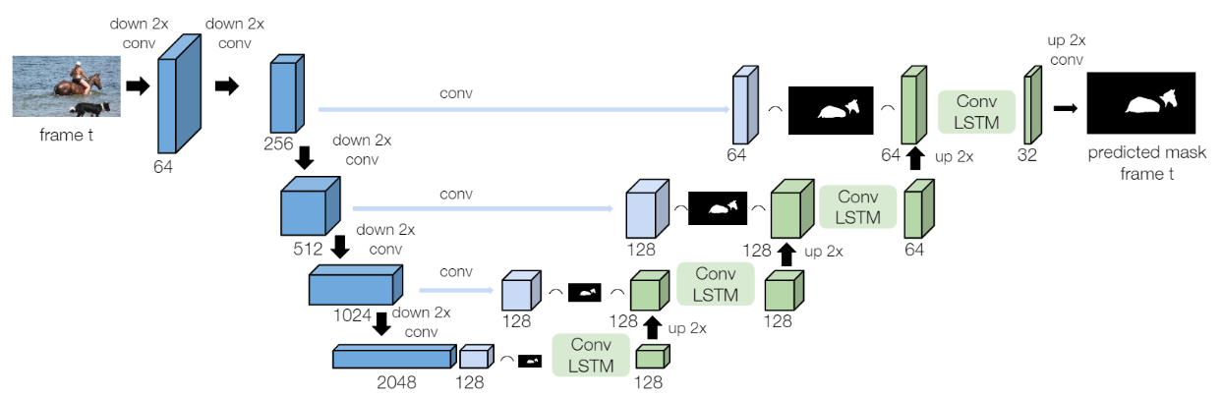
How RVOS Works
RVOS: End-to-End Recurrent Network for Video Object Segmentation - Ventura et al.
Encoder
Pulls features
from set of input images
Decoder
Segments images
from pulled features
Notes:
Once we created a large trainable dataset, we trained with the synthetic dataset and tested with the existing FMOv2 data. Something unique about RVOS is that it has an encoder to extract features from the images. These features are inputs to the decoder which segments the image with Convolutional LSTMs.

Slide 23
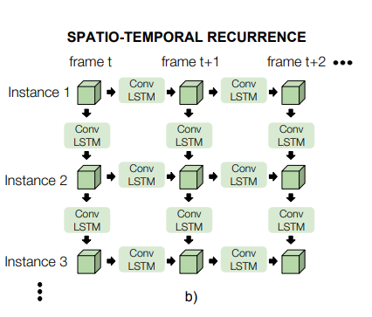
RVOS - Information Flow
Notes:
Spatio-temporal recurrence is achieved by incorporating LSTMs and Convolutions. Intuitively, spatial information is useful when tracking FMOs because they can appear distorted and blurry to different extents in each frame. Temporal information is useful for tracking FMOs because they accelerate, meaning that their displacements are different between every frame.

Slide 24
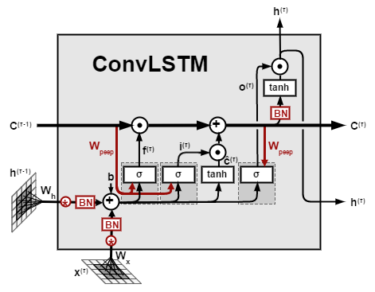
RVOS - Chosen Convolutional LSTM Architecture
Output spatial 2D features
Spatio-temporal information
End-to-end Realtime
Zero-shot segmentation
Input temporal features
Output temporal features
Input spatial 2D features
RVOS: End-to-End Recurrent Network for Video Object Segmentation - Ventura et al.
Notes:
As we learned about LSTMs in class, activation functions aid the weight tuning process with hidden features from input images. Similarly, ConvLSTMs use two dimensional features from frames and information gathered between frames to output a prediction of the next instance.

Slide 25
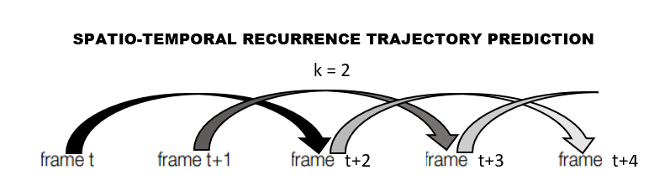
Trajectory Prediction, Training & Evaluation
RVOS
tracking by
segmentation
Ours
Prediction of object
k frames ahead
Notes:
So far we have been talking about tracking by segmentation, but our FMO trajectory prediction concept is not radically different. RVOS was able to track the objects, but we reordered the ground-truth to investigate whether RVOS can also predict future frames. We further customized the datasets and will show you how we tested our trajectory prediction concept.

Slide 26
Novelty
Created synthetic video dataset.
Applied end-to-end neural network with spatio-temporal recurrence to FMO dataset.
Originated trajectory prediction method concept for FMOs.
Notes:
Before Kristi Bushman guides through our results, lets reiterate that we created a large FMO video dataset, we were the first to track FMOs with an end-to-end ConvLSTM model, and we were the first to predict FMO instances in future frames.

Slide 27
Results
Tracking
Trajectory Prediction
Notes:
How well did the authors describe their experimental validation? How informative were the figures used? (1-5)
Were all/most relevant experimental settings (e.g. datasets, tasks) and baselines (competitor methods) included in the experimental validation? (1-5)
Show hyperparameters , comparison metrics and baseline comparisons!!!!!

Slide 28
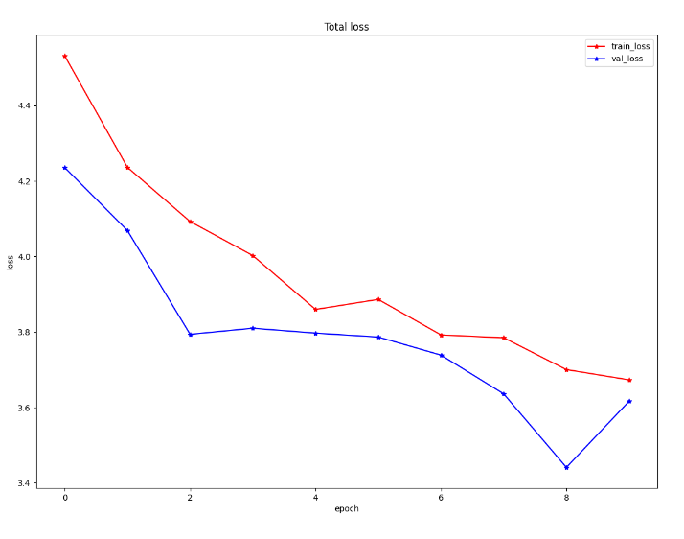
Experimental Setup
Metrics
Precision, Recall, F1 Score
Not pixel wise, but image-wise where TP = IoU > 0.5
Hyperparameters
Learning rate, number of epochs, kernel size
Best result: 0.0005 learning rate, 10 epochs, 3 kernel size
Additional experiments
Loss function = IoU + penalty for more than 1 connected component
Worse results than IoU alone

Slide 29
Results - FMOv2 Dataset
 | Ours |  |  | World of FMOs |  |  | FMO seg - small |  |  | FMO seg - large
Video | Pr | Rc | F1 | Pr | Rc | F1 | Pr | Rc | F1 | Pr | Rc | F1
blue | 0.77 | 0.62 | 0.68 | 1.00 | 0.52 | 0.69 | 0.40 | 0.27 | 0.32 | 0.58 | 0.44 | 0.50
volleyball1 | 0.39 | 0.92 | 0.55 | 1.00 | 0.46 | 0.63 | 0.00 | 0.00 | 0.00 | 0.33 | 0.43 | 0.38
squash | 0.00 | 0.00 | 0.00 | 0.00 | 0.00 | 0.00 | 0.26 | 0.84 | 0.40 | 0.22 | 0.76 | 0.34
ping_pong_paint | 0.38 | 0.20 | 0.26 | 1.00 | 0.89 | 0.94 | 0.59 | 0.67 | 0.62 | 0.00 | 0.00 | 0.00
softball1 | 0.00 | 0.00 | 0.00 | 0.67 | 0.15 | 0.25 | 0.83 | 0.83 | 0.83 | 0.55 | 0.67 | 0.60
ping_pong_top | 0.03 | 0.03 | 0.03 | 0.93 | 0.88 | 0.90 | 0.56 | 0.99 | 0.72 | 0.00 | 0.00 | 0.00
hockey | 0.02 | 0.09 | 0.03 | 1.00 | 0.16 | 0.28 | 0.24 | 0.87 | 0.38 | 0.20 | 0.92 | 0.33
darts_window1 | 0.00 | 0.00 | 0.00 | 0.25 | 0.50 | 0.33 | 0.33 | 0.33 | 0.33 | 0.33 | 0.33 | 0.33

Slide 30
Results - FMOv2 Dataset
 | Ours |  |  | World of FMOs |  |  | FMO seg - small |  |  | FMO seg - large
Video | Pr | Rc | F1 | Pr | Rc | F1 | Pr | Rc | F1 | Pr | Rc | F1
tennis_serve_back | 0.00 | 0.00 | 0.00 | 0.29 | 0.06 | 0.10 | 0.35 | 0.69 | 0.47 | 0.26 | 0.70 | 0.38
volleyball_passing | 0.72 | 0.65 | 0.68 | 0.22 | 0.10 | 0.14 | 0.20 | 0.16 | 0.18 | 0.85 | 0.98 | 0.91
frisbee | 0.06 | 0.20 | 0.10 | 1.00 | 1.00 | 1.00 | 0.00 | 0.00 | 0.00 | 0.95 | 0.95 | 0.95
tennis1 | 0.00 | 0.00 | 0.00 | 0.00 | 0.00 | 0.00 | 0.33 | 0.41 | 0.37 | 0.20 | 0.92 | 0.33
darts1 | 0.00 | 0.00 | 0.00 | 1.00 | 0.27 | 41.7 | 0.37 | 0.63 | 0.47 | 0.33 | 1.00 | 0.50
ping_pong_side | 0.00 | 0.00 | 0.00 | 0.12 | 0.07 | 0.09 | 0.45 | 0.79 | 0.58 | 0.00 | 0.00 | 0.00
tennis_serve_side | 0.16 | 0.22 | 0.19 | 1.00 | 0.59 | 0.74 | 0.67 | 0.77 | 0.71 | 0.35 | 0.86 | 0.50
william_tell | 0.00 | 0.00 | 0.00 | 0.00 | 0.00 | 0.00 | 0.25 | 0.20 | 0.22 | 0.18 | 1.00 | 0.32

Slide 31
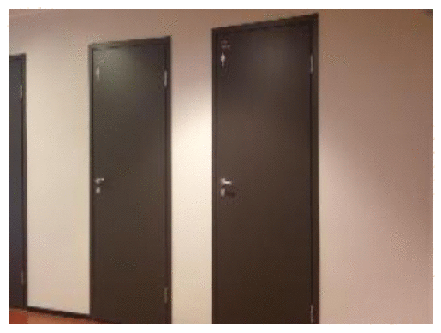
Results - Tracking

Slide 32
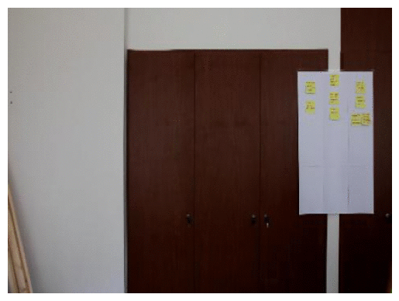
Results - Tracking

Slide 33
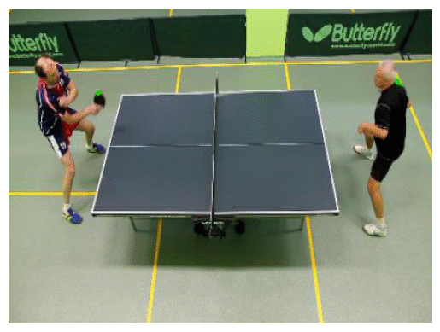
Results - Tracking

Slide 34
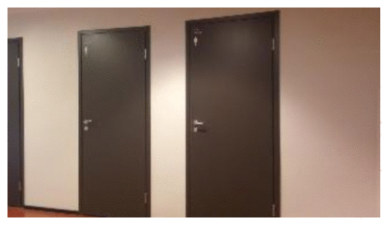
Results - Trajectory Prediction

Slide 35
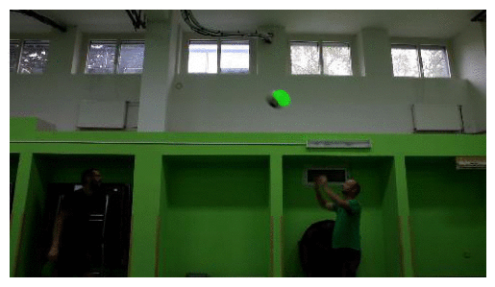
Results - Trajectory Prediction

Slide 36
Conclusions & Limitations
Challenging for a single model to learn all variations of object sizes and shapes
Inconclusive on whether recurrent architecture was helpful
Different architecture and different dataset generator
Trajectory prediction results are promising

Slide 37
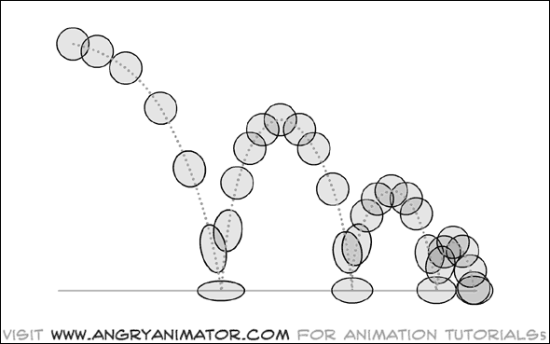
Future Work
Further optimize realistic dataset generator
Parabolic Curves
Bouncing
Multiple Objects
Test variation of more frames ahead in trajectory prediction

Slide 38
Questions?

